Slide 1
Which talks are popular and why – TED Talks analysis
DATA 512 Project Presentation
Sha Li

Slide 2

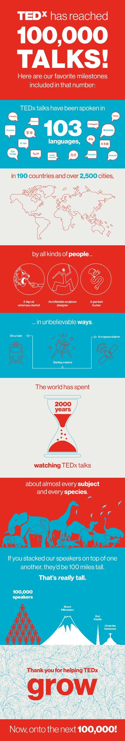
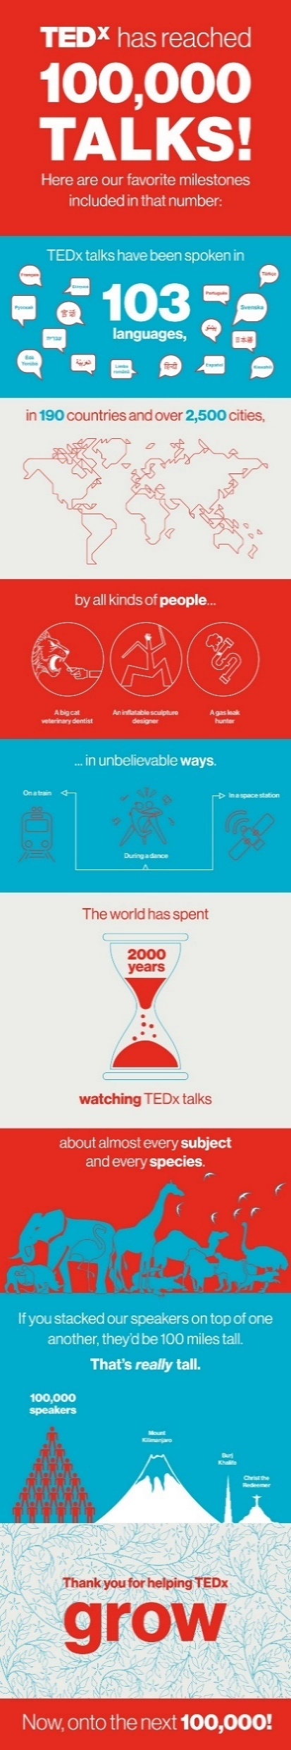
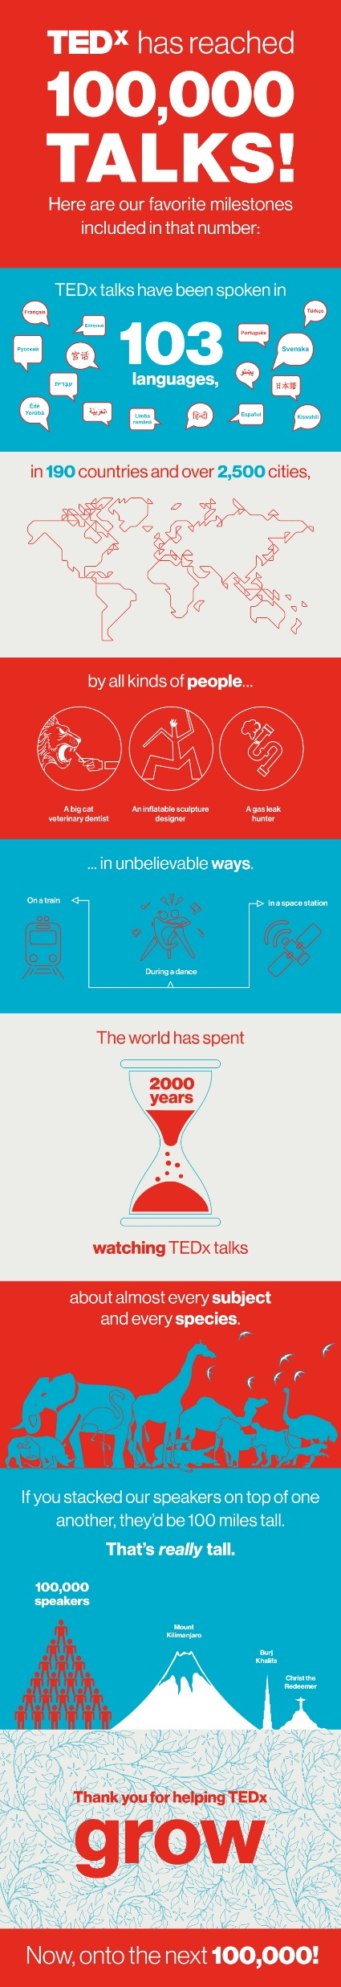

Why TED matters
TED is a nonprofit organization born in 1984. Originally, it was set up as a platform for professionals to share their innovative ideas and the topics were restricted in technology, entertainment and design fields.
Nowadays, TED has already become an unparalleled phenomenon, attracting millions of people worldwide to watch, present, discuss and think on hundreds of topics.
Figures cited from https://blog.ted.com/achievement-unlocked-tedx-celebrates-100000-talks/

Slide 3

What Do I Want to Learn from This Study
We already know TED Talks matter and they are popular.
We don’t know what are the specific factors that relate to TED Talks popularity.
My study is going to answer the following questions:
How do you define TED talks popularity?
Which TED talks are popular?
Which topics/themes are more popular?
Why some talks are more popular? Is it because of topics, time, speaker or even presentation skills?
How can we use the results of this study to understand TED talks audiences and design better TED talks in the future?

Slide 4
Data source
Two datasets will be used for this project from Kaggle
18 variables and ~2500 records in total.
Released under CC BY-NC-SA 4.0
The datasets contain all audio-video recordings of TED talks on the official TED website from January 10th, 2006 to September 21st, 2017. One includes basic information and the other includes transcript of the talk.

Slide 5
RQ1: Define Popularity

Slide 6
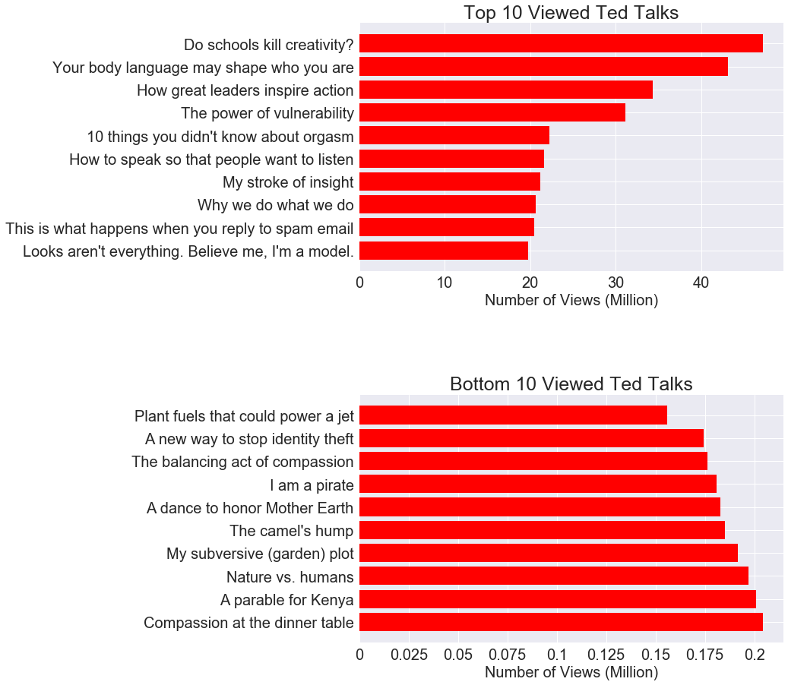
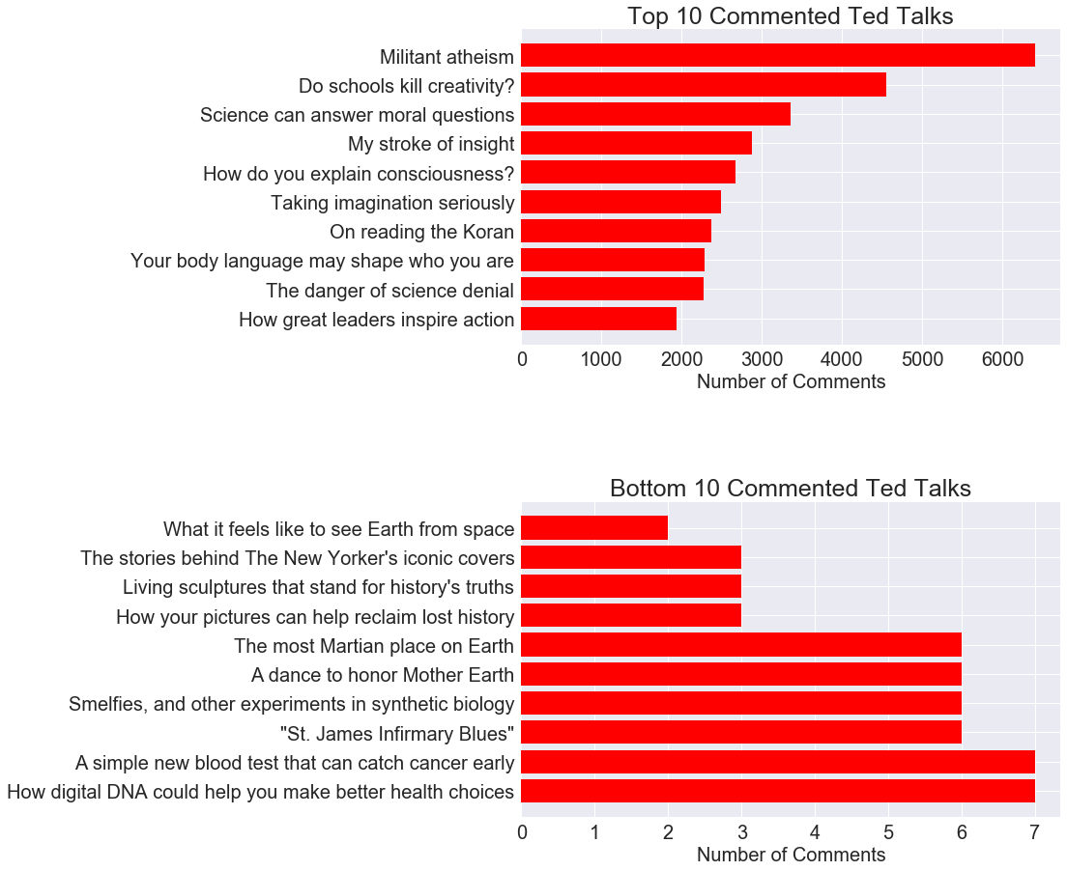
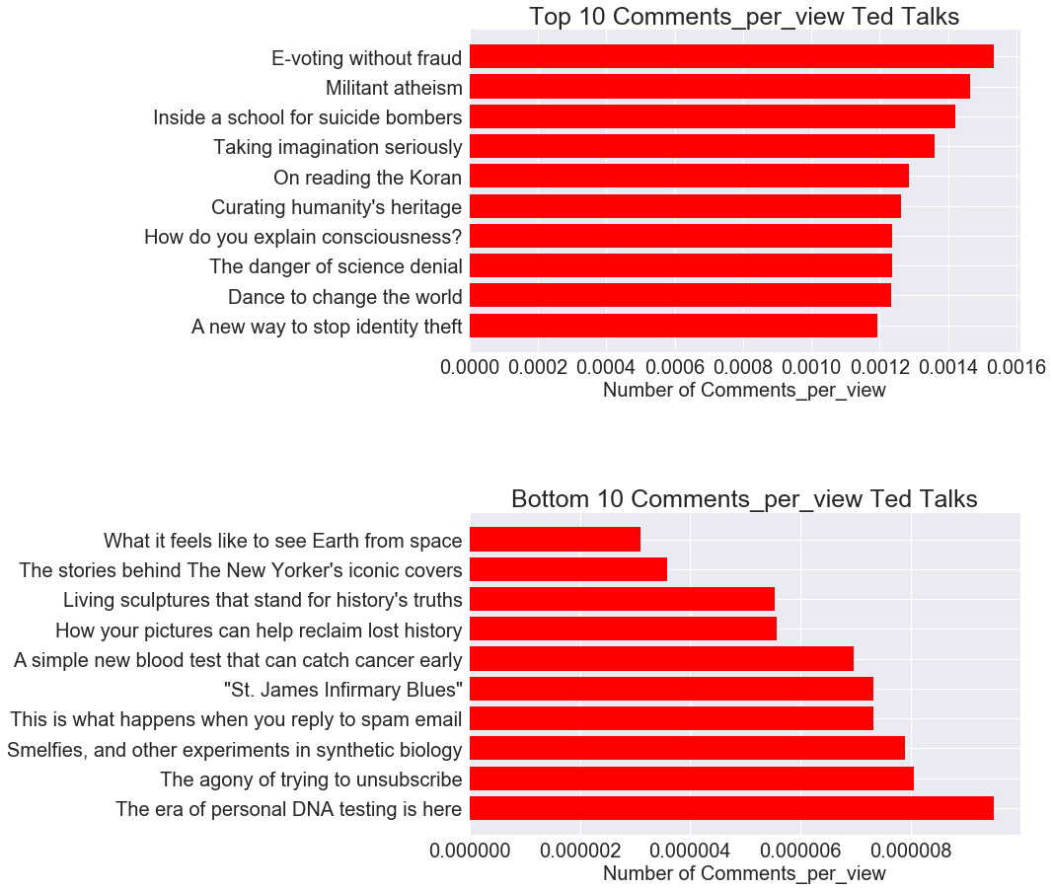
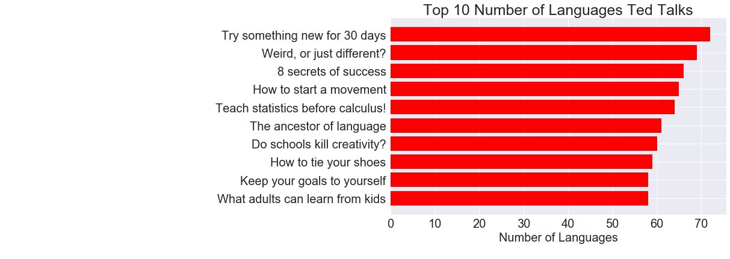
Views
Comments
Comments per view
Languages
Top 1 viewed talk “Do schools kill creativity” didn’t even make into the top 10 comments per view list. On the contrary, “Militant atheism” raised more comments compared to its view numbers.
More…
Analysis results are drastically different using different definition of popularity!

Slide 7
RQ2: Topic Vs Popularity

Slide 8
Hypothesis2a Ted Topics related to technology, entertainment and design are more popular.
By view | By comment | By comments per view | By number of languages
Culture | Culture | Technology | Technology
Technology | Technology | Global issues | Science
Science | Global issues | Culture | Culture
Business | Science | Science | Global issues
TEDx | TEDx | TEDx | Design
Global issues | Business | Design | TEDx
Entertainment | Design | Business | Business
Design | Entertainment | Entertainment | Entertainment
Psychology | Brain | Politics | Health
Brain | Psychology | Health | Art
Technology, entertainment and design are indeed belong to the top 10 popular topics.
The most top popular topics, however, are technology, culture, science and global issues.
Business, Psychology and brains received more views, while politics and health tends to raise more comments, and art is welcome globally.

Slide 9
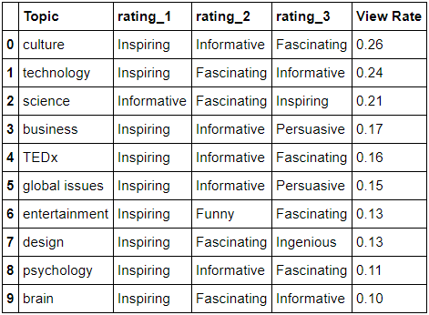
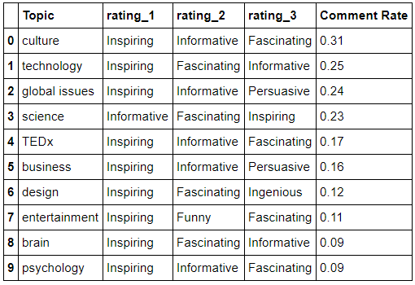
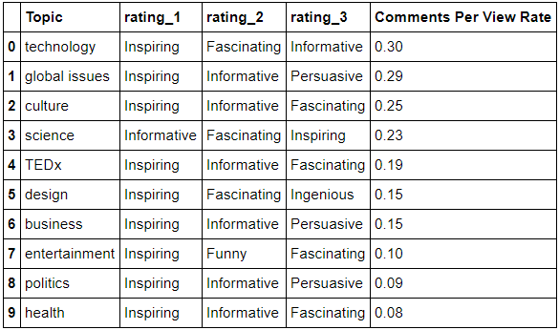
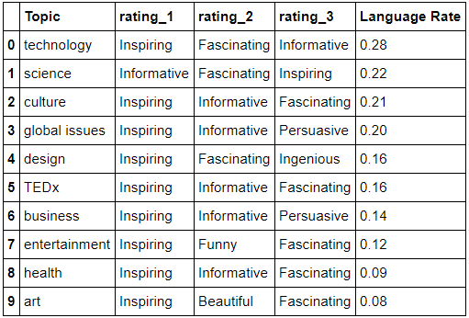
Hypothesis2b topics are more popular because they are informative rather than funny or surprising.
Topics are more popular mostly because they are inspiring!
Topics are more popular also because they are informative or fascinating.
Positive ratings such as beautiful, courageous, jaw-dropping didn't make into the top reasons for popularity list.

Slide 10
RQ3: Time Vs Popularity

Slide 11
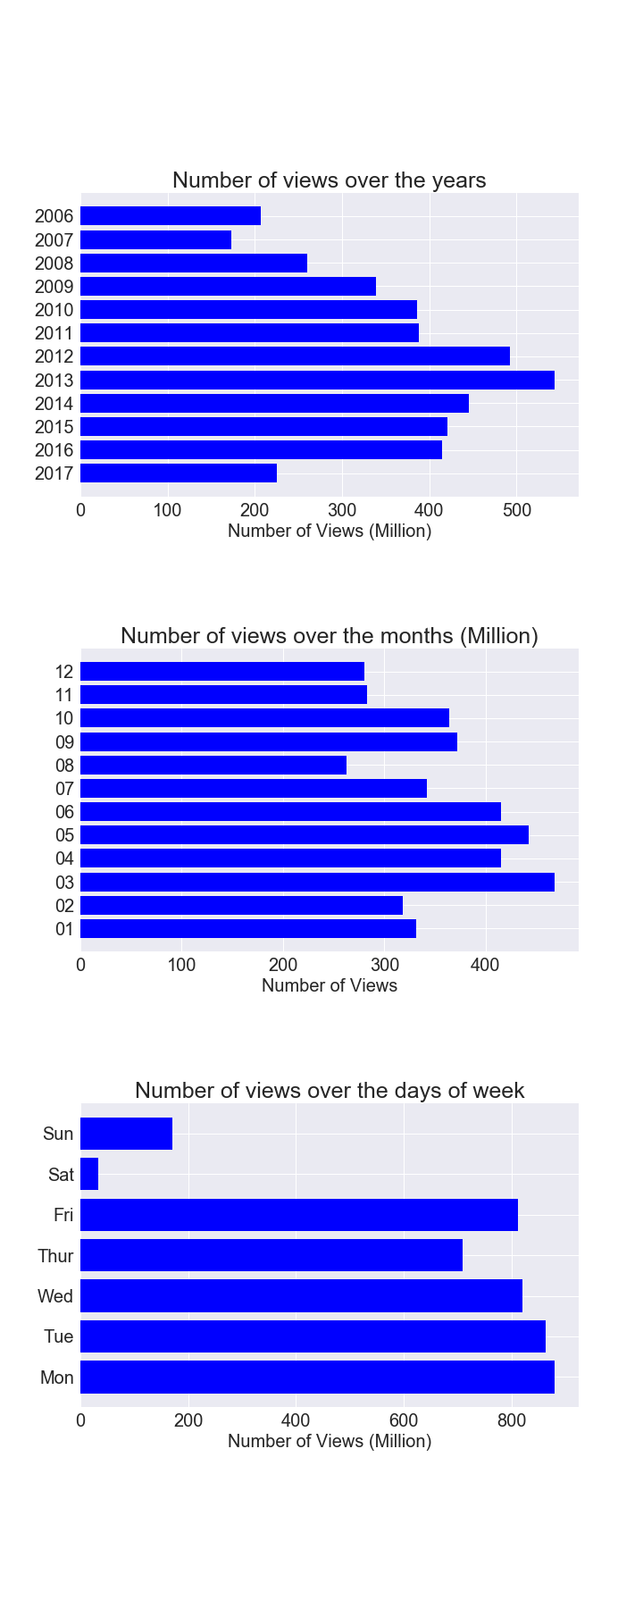
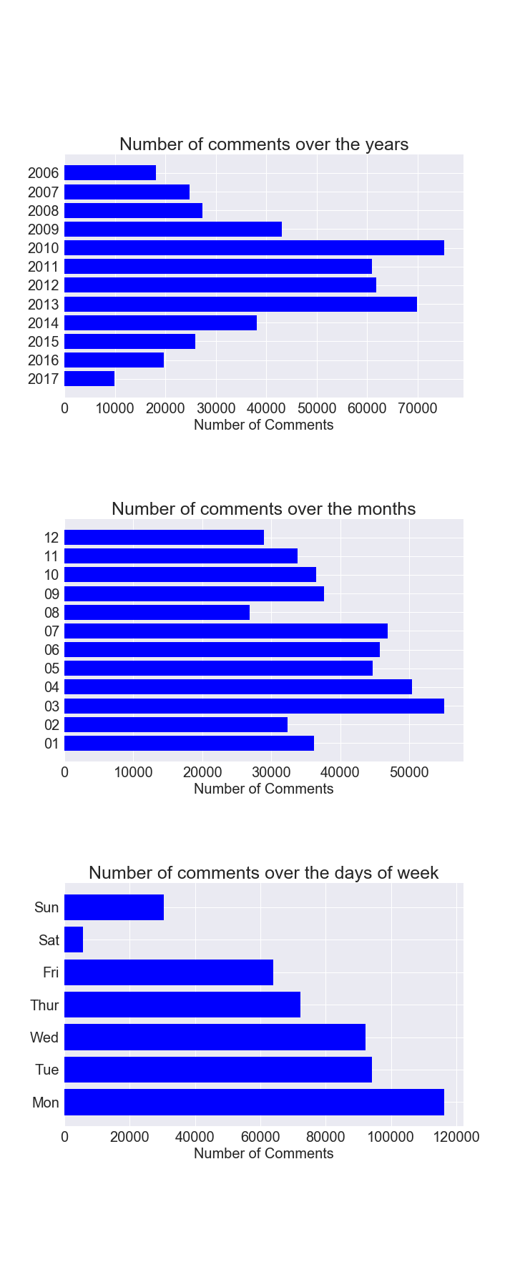
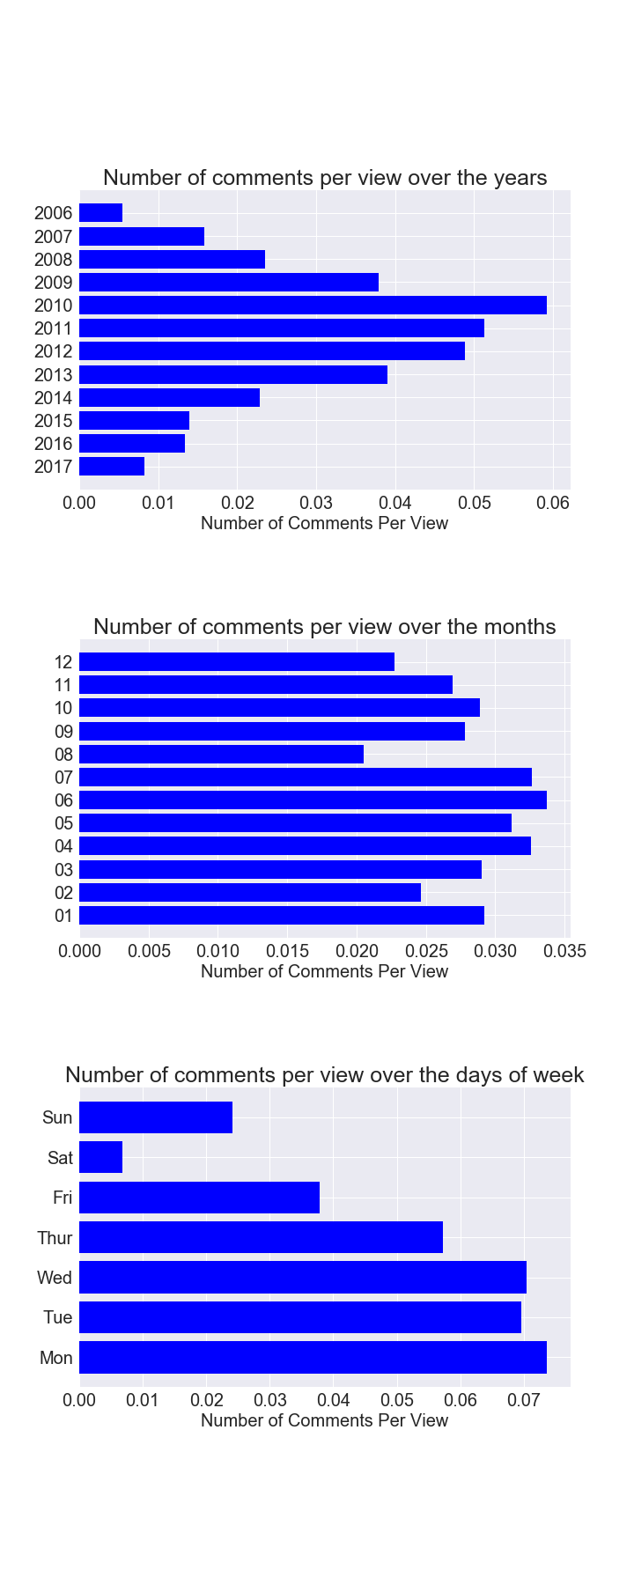
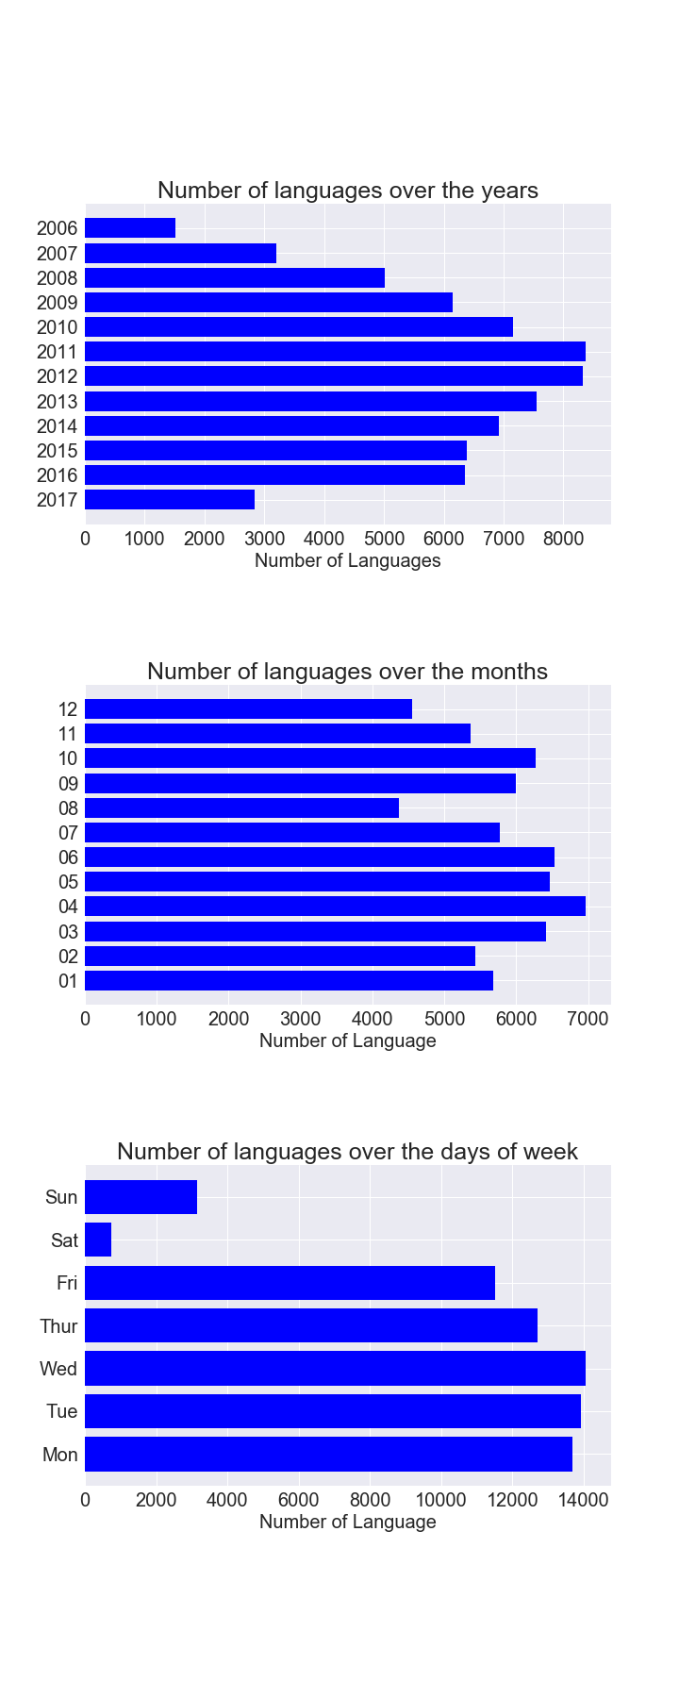
Hypothesis3a TED Talks are becoming more and more popular over the past 10 years.
TED talks popularity was climbing from 2006 (since its available free online) to 2013, and experienced decline from 2013 to nowadays.

Slide 12
RQ4: speaker Vs Popularity

Slide 13
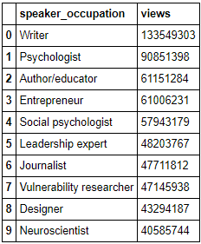
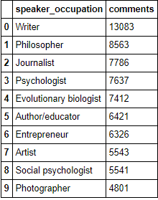
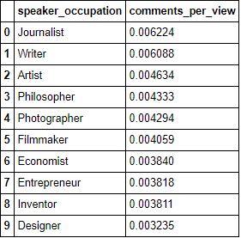
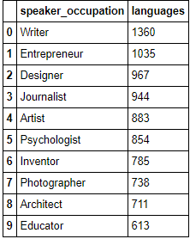
Hypothesis4b TED Talks given by speakers with occupations having more chances to give public speeches are more popular.
Writer, Journalist, entrepreneur are the most popular occupations among the most popular talks. They are not necessarily occupations with more chances for public speaking, but they generally have diverse experience and good at sharing sympathy with people.
Other top popular occupations among the most popular talks are psychologist, photographer and artist.
Among the most common occupations for TED talks (data not shown on this slide), architect and filmmaker do not give as popular talks as other top occupations.

Slide 14
RQ5: Presentation skills Vs Popularity

Slide 15
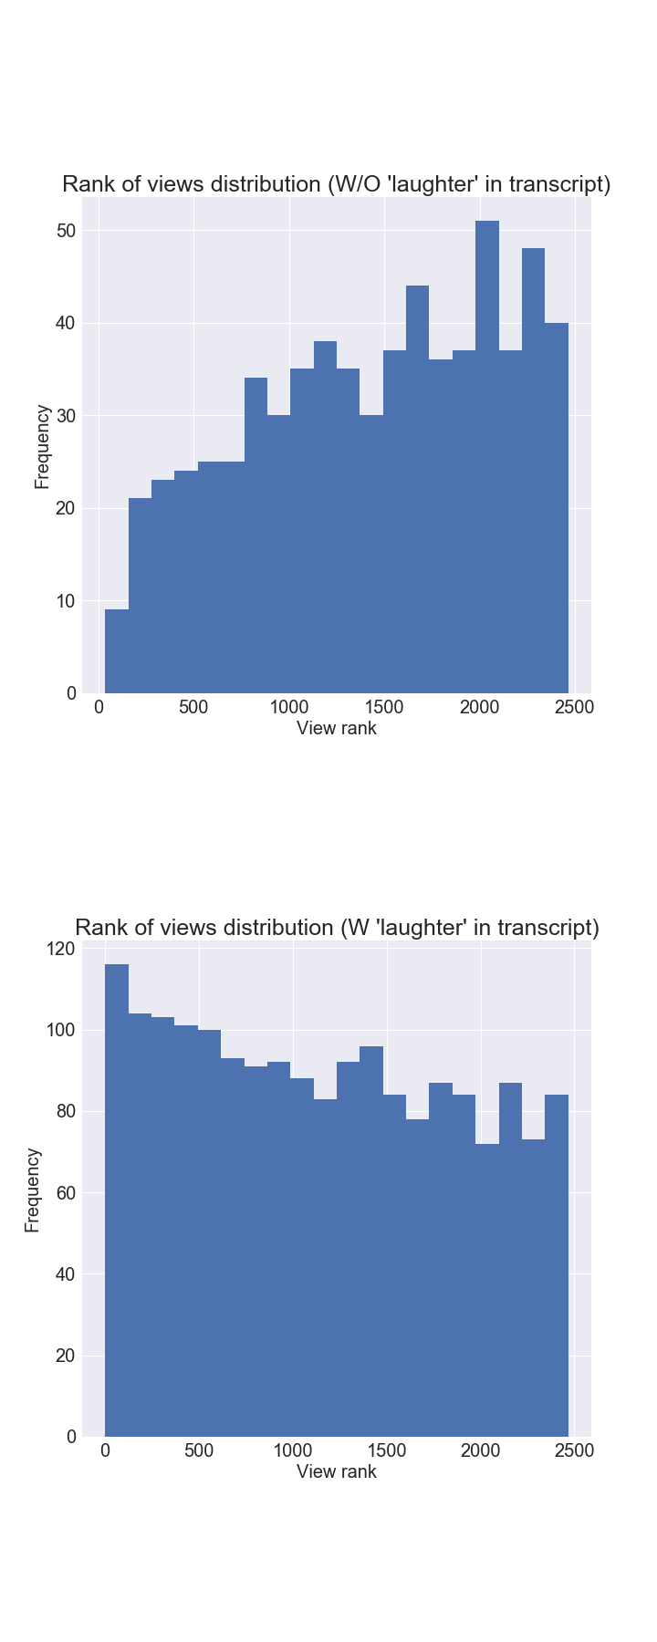
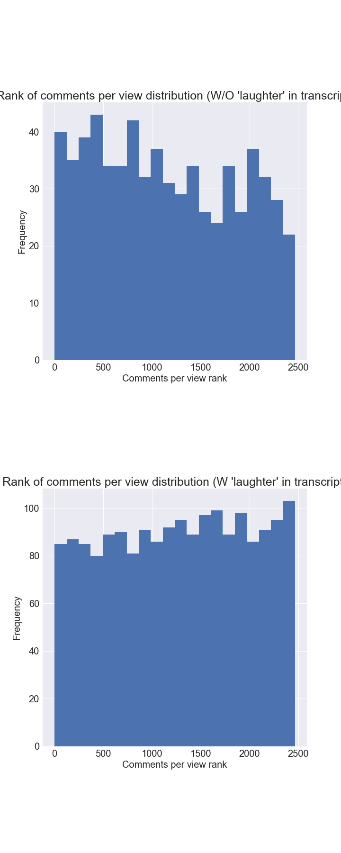
Hypothesis5a Medium length TED Talks are more popular.
Medium length talks (10-20 mins) are most common and most popular talks as well. Followed by short(less than 10 mins), long(20-30 minutes) and extra long talks(>30 mins).
Hypothesis5b TED Talks that started with a question are more popular.
For TED talks with a question mark in their titles, they are generally more popular (rank higher in popularity lists) than those without, but not significant differences.
Hypothesis5c TED Talks presented in humorous ways are more popular.
For TED talks with at least one ‘laughter’ in their transcripts, they are generally more often viewed.
However, these humorous talks don’t raise more discussions per view compared to other talks, suggest that the ability to inspire people is more important than make people laugh in order to raise follow up thoughts among audiences.

Slide 16
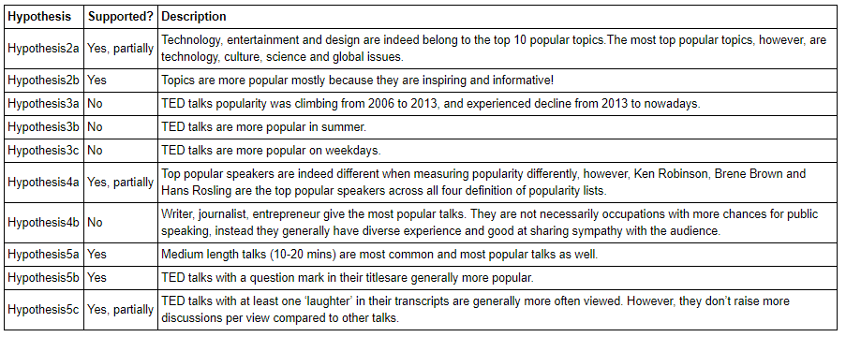
Conclusions

Slide 17
Human-centered data science reflections
Reproducibility and replicability of open research
My efforts were: 1) Clearly defined popularity concepts, four different aspects were considered, so my the audiences of my study can use results wisely based on their preference of popularity concepts. 2) All calculation metrics and constraints were clearly defined in this study, such as view rank/comment rank, view rate/comment rate. 3) Any literature or code references were clearly claimed.
Bias exist in both source data and my study design/analysis
Bias in original data: 1) contents limitation 2) validity limitation
Bias in study design: 1) Four definitions of popularity are proposed. 2) Research questions are designed surrounding four aspects: topic, speaker, time and presentation skills.

Slide 18
Thank you and questions?

